Slide 1
CSE 105 theory of computation
Fall 2020 Week 10

Slide 2
Table of Contents – Quickly Jump to a video’s slides
Monday | Wednesday | Friday
Video 126 | Video 130 | Review
Video 127 | Video 131
Video 128 | Examples
Video 129 | FAQ
Examples
FAQ

Slide 3
This week’s learning goals
Distinguish between computability and complexity
Articulate motivating questions of complexity
Define NP-completeness
Give examples of NP-complete problems
Use polynomial-time reduction to prove NP-completeness

Slide 4
Monday
Videos 126-129
Today’s learning goals
Distinguish between computability and complexity
Articulate motivating questions of complexity
Define NP-completeness
Give examples of NP-complete problems
Use polynomial-time reduction to prove NP-completeness
Today’s textbook sections
Section 7.4, 7.5: NP-completeness

Slide 5
126.CSE105.NondeterministicTimeComplexity.mp4
Remember:
Given a nondeterministic Turing machine/Decider, we can always build a one-tape deterministic Turing machine/Decider that recognizes the same language.

Slide 6
What about nondeterminism?
q0
q0
deterministic computation
non-
deterministic computation
q_{acc}
q_{rej}
q_{acc}
q_{rej}
q_{rej}

Slide 7
Time complexity
For M a deterministic decider, its running time or time complexity is the function f: N → R⁺ given by
f(n) = maximum number of steps M takes before halting,
over all inputs of length n.
For M a nondeterministic decider, its running time or time complexity is the function f: N → R⁺ given by
f(n) = maximum number of steps M takes before halting on any branch of its computation, over all inputs of length n.

Slide 8
Time complexity classes
DTIME ( t(n) ) = { L | L is decidable by O( t(n) )
deterministic, single-tape TM }
NTIME ( t(n) ) = { L | L is decidable by O( t(n) )
nondeterministic, single-tape TM }
Is DTIME(n²) is a subset of DTIME(n³)?
Yes
No
Not enough information to decide
I don't know

Slide 9
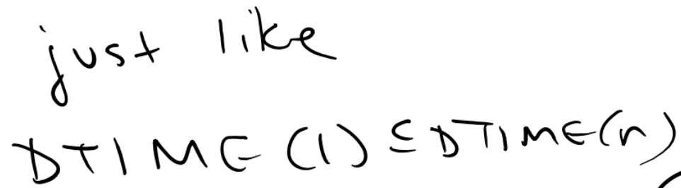
Time complexity classes
DTIME ( t(n) ) = { L | L is decidable by O( t(n) )
deterministic, single-tape TM }
NTIME ( t(n) ) = { L | L is decidable by O( t(n) )
nondeterministic, single-tape TM }
Is DTIME(n²) is a subset of DTIME(n³)?
Yes
No
Not enough information to decide
I don't know

Slide 10
Time complexity classes
DTIME ( t(n) ) = { L | L is decidable by O( t(n) )
deterministic, single-tape TM }
NTIME ( t(n) ) = { L | L is decidable by O( t(n) )
nondeterministic, single-tape TM }
Is DTIME(n²) is a subset of NTIME(n²)?
Yes
No
Not enough information to decide
I don't know

Slide 11
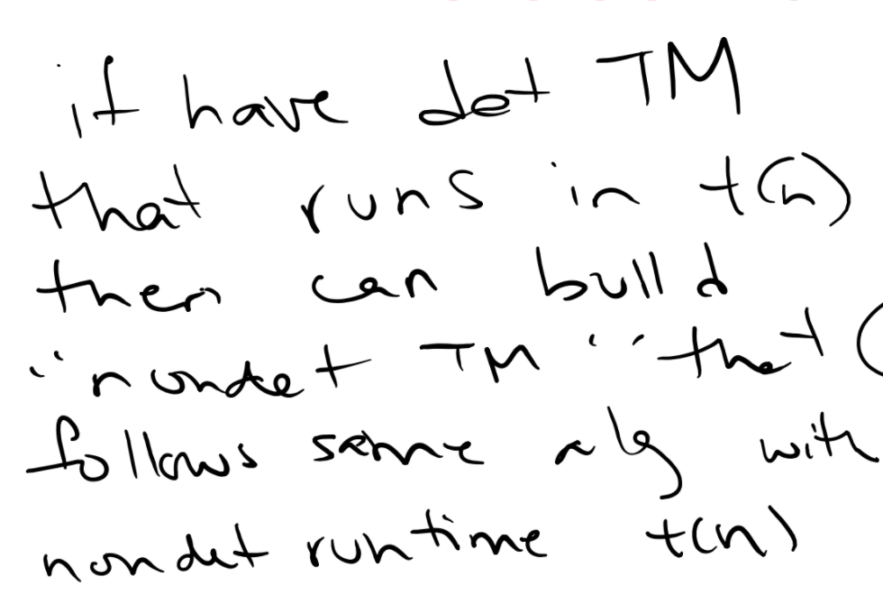

Time complexity classes
DTIME ( t(n) ) = { L | L is decidable by O( t(n) )
deterministic, single-tape TM }
NTIME ( t(n) ) = { L | L is decidable by O( t(n) )
nondeterministic, single-tape TM }
Is DTIME(n²) is a subset of NTIME(n²)?
Yes
No
Not enough information to decide
I don't know

Slide 12
Time complexity classes
DTIME ( t(n) ) = { L | L is decidable by O( t(n) )
deterministic, single-tape TM }
NTIME ( t(n) ) = { L | L is decidable by O( t(n) )
nondeterministic, single-tape TM }
Is NTIME(n²) is a subset of DTIME(n²)?
Yes
No
Not enough information to decide
I don't know

Slide 13
P vs. NP

Slide 14
Key Notation and Definitions (126)
Deterministic TMs can be converted into nondeterministic TMs that have the same runtime.
The big question of P vs. NP concerns whether we can convert a nondeterministic computation tree to a linear computation effectively.

Slide 15
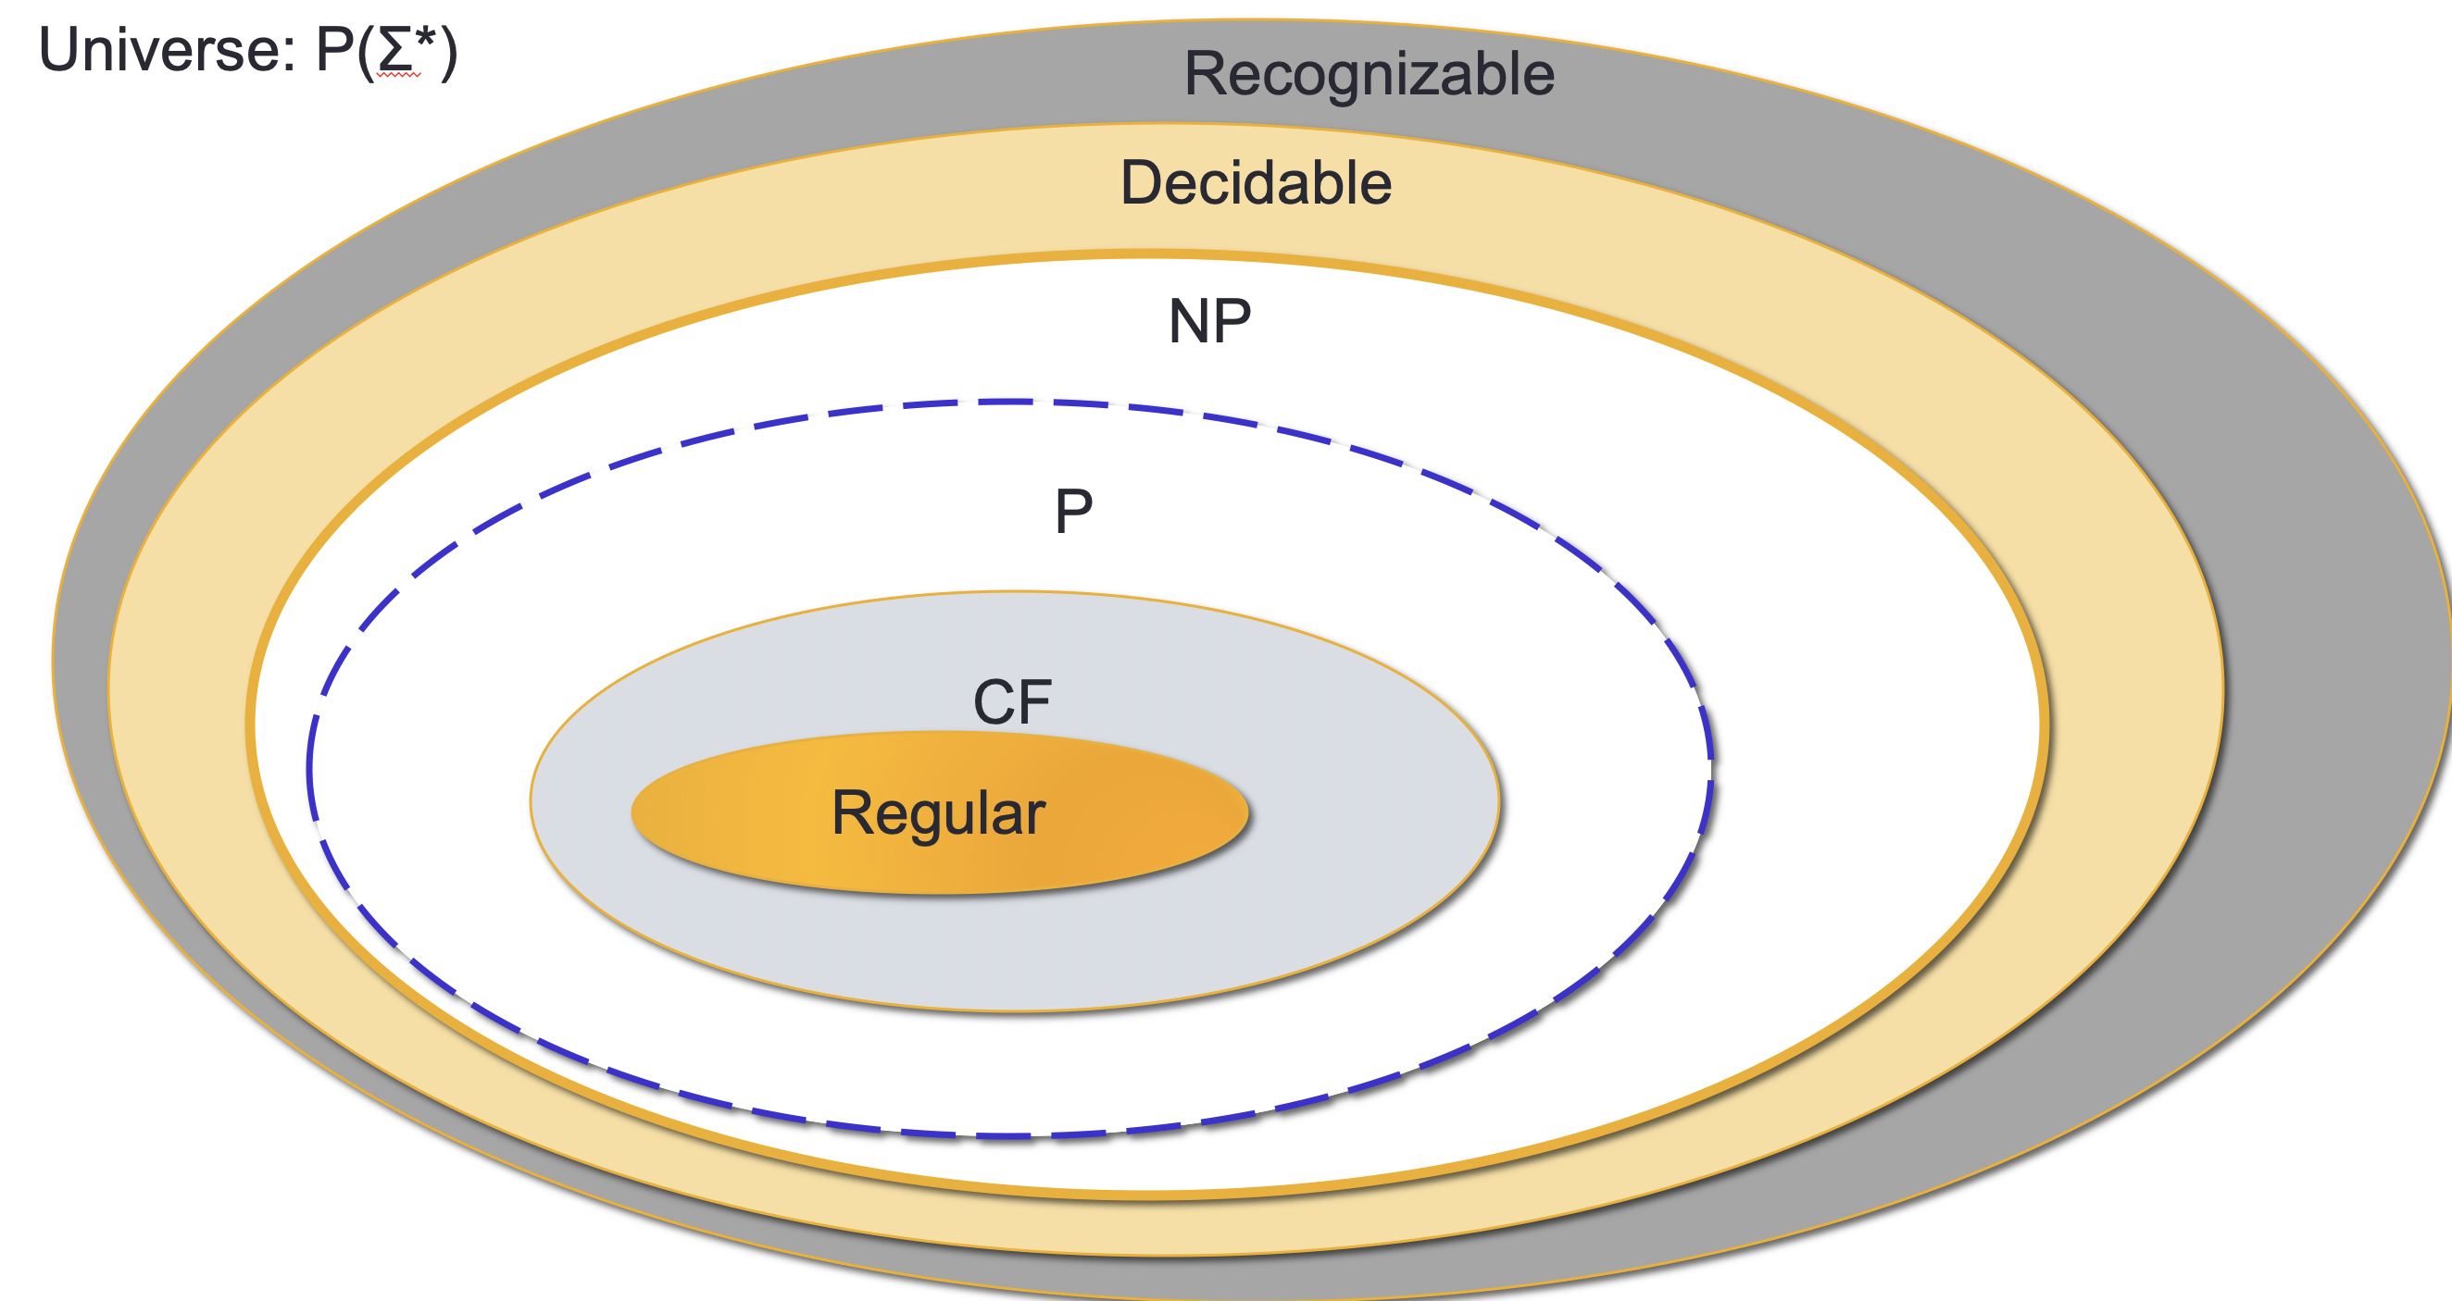
127.CSE105.ComplexityFeasibleVsVerifiable.mp4
Useful graph:

Slide 16
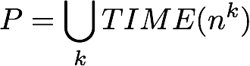
"Feasible" i.e. P
Can't use nondeterminism
Can use multiple tapes
Often need to be “more clever” than naïve / brute force approach
Examples
PATH = {<G,s,t> | G is digraph with n nodes there is path from s to t}
Use breadth first search to show in P
RELPRIME = { <x,y> | x and y are relatively prime integers}
Use Euclidean Algorithm to show in P
L(G) = {w | w is generated by G} where G is any CFG
Use Dynamic Programming to show in P

Slide 17

"Verifiable" i.e. NP
Can be decided by a nondeterministic TM in polynomial time
Best known deterministic solution is brute-force
Solution can be verified by a deterministic TM in polynomial time
P = NP?

Slide 18
Examples in NP
Solution can be verified by a deterministic TM in polynomial time
HAMPATH = {<G,s,t> | G is digraph with n nodes there is path from s to t that goes through every node exactly once}
VERTEX-COVER = { <G,k> | G is an undirected graph with n nodes that has a k-node vertex cover}
CLIQUE = { <G,k> | G is an undirected graph with n nodes that has a k-clique}
SAT = { < X > | X is a satisfiable Boolean formula with n variables}

Slide 19
P vs. NP
Problems in P | Problems in NP
(Membership in any) regular language | Any problem in P
(Membership in any) CFL | HAMPATH
PATH | CLIQUE
A_{DFA} | VERTEX-COVER
E_{DFA} | TSP
EQ_{DFA} | SAT
Addition, multiplication of integers | …

Slide 20
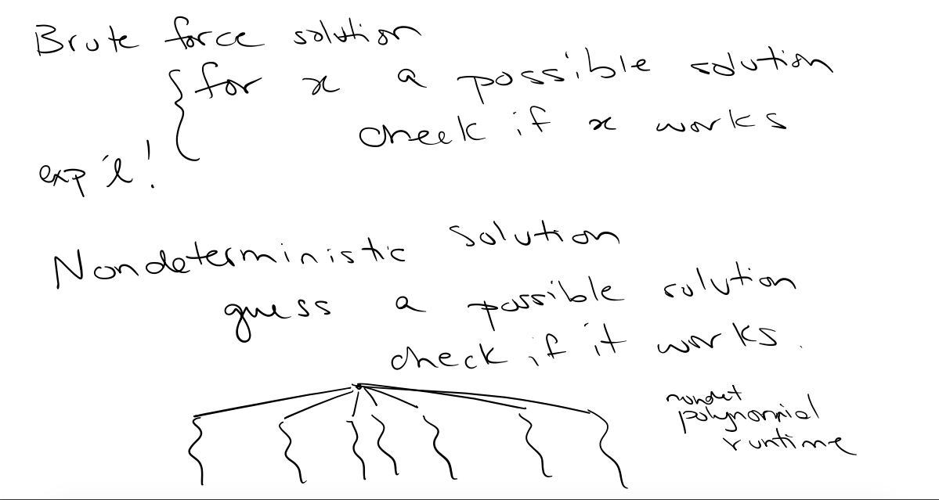

Slide 21
Key Notation and Definitions (127)
NP problems
Can be decided by a nondeterministic TM in polynomial time
Solution can be verified by a deterministic TM in polynomial time
Any problem in P is also in NP

Slide 22
128.CSE105.ComplexityPolynomialTimeReductions.mp4
Remember:
A problem is assigned to the P class if there exists at least one algorithm to solve that problem, such that the number of steps of the algorithm is bounded by a polynomial in n, where n is the length of the input.

Slide 23
P vs. NP
Problems in P | Problems in NP
(Membership in any) regular language | Any problem in P
(Membership in any) CFL | HAMPATH
PATH | CLIQUE
A_{DFA} | VERTEX-COVER
E_{DFA} | TSP
EQ_{DFA} | SAT
Addition, multiplication of integers | …

Slide 24
How to answer P = NP ?
Are there hardest NP problems?
If so, finding an efficient solution for one of them would guarantee that all NP problems have efficient solutions.

Slide 25
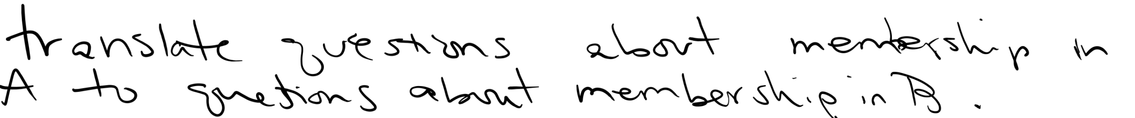
How to answer P = NP ?
Are there hardest NP problems?
Complexity-theoretic meaning for “A is no harder than B”:
Problem A is polynomial-time mapping reducible to problem B means there is a polynomial-time computable function f such that, for all x,
x is in A iff f(x) is in B.

Slide 26
Key Notation and Definitions (128)
Finding an efficient solution for the hardest NP problem would guarantee that all NP problems have efficient solutions.

Slide 27
129.CSE105.UsingPolynomialTimeReductions.mp4
Remember:
"Problem A is mapping reducible to problem B" means that there is a computable function f: Σ* → Σ* such that for all strings x in Σ*:
x is in A iff f(x) is in B

Slide 28
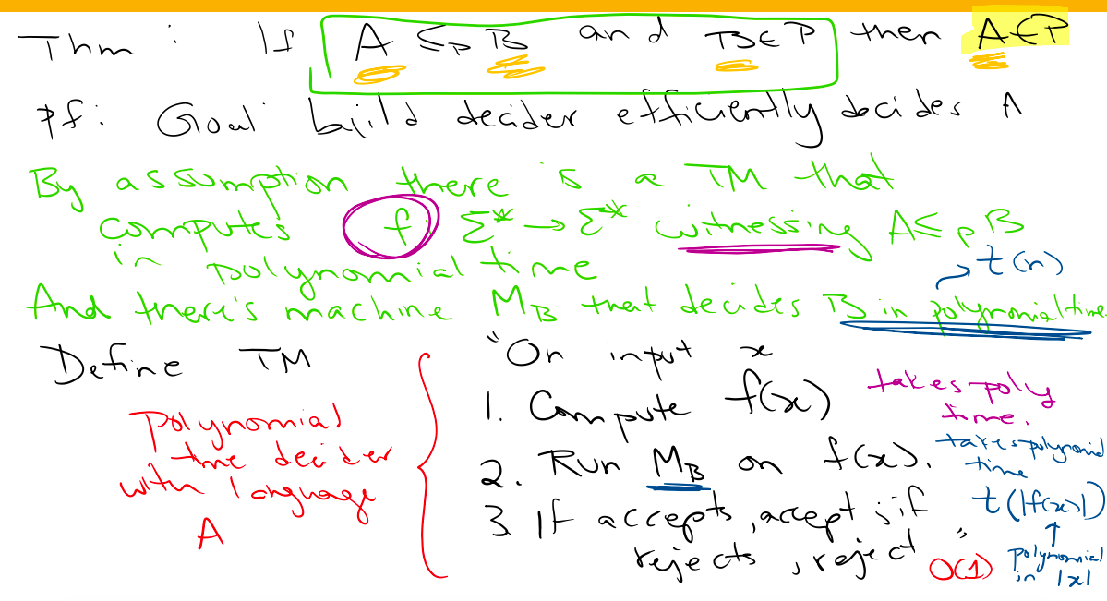

Slide 29
Key Notation and Definitions (129)
If each step of a TM takes polynomial time, then the TM is a polynomial time decider.
We now have a general approach to produce efficient algorithms. If A mapping reduces to B and there exists an efficient algorithm for B, then A also has an efficient algorithm.

Slide 30
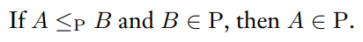
Applying Polynomial Time Reductions
Example 1
Prove the following:
Where A and B are languages
Theorem 7.31 pg. 301

Slide 31
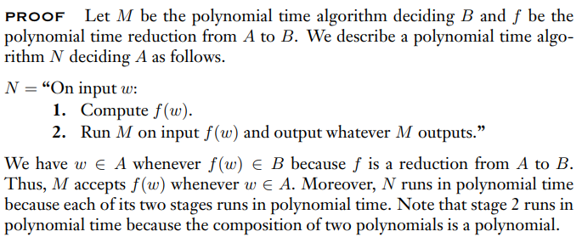
Example 1 Solution
Theorem 7.31 pg. 301

Slide 32
Monday FAQ (126-129)
Q: “What is the difference between computing a problem and verifying it?”
A: When we compute a problem, we are trying to find solutions to that problem. When we verify a problem, we are checking that something is a solution to that problem.
Q: "Are all problems with algorithmic solutions guaranteed to be in NP?"
A: No, NP does not equal the class of decidable languages. There are some problems that take exponential time and cannot be solved in nondeterministic polynomial time.

Slide 33
Wednesday
Videos 130-131
Today’s learning goals
Use polynomial-time reduction to prove NP-completeness
Give examples of NP-complete problems
Today’s textbook sections
None

Slide 34
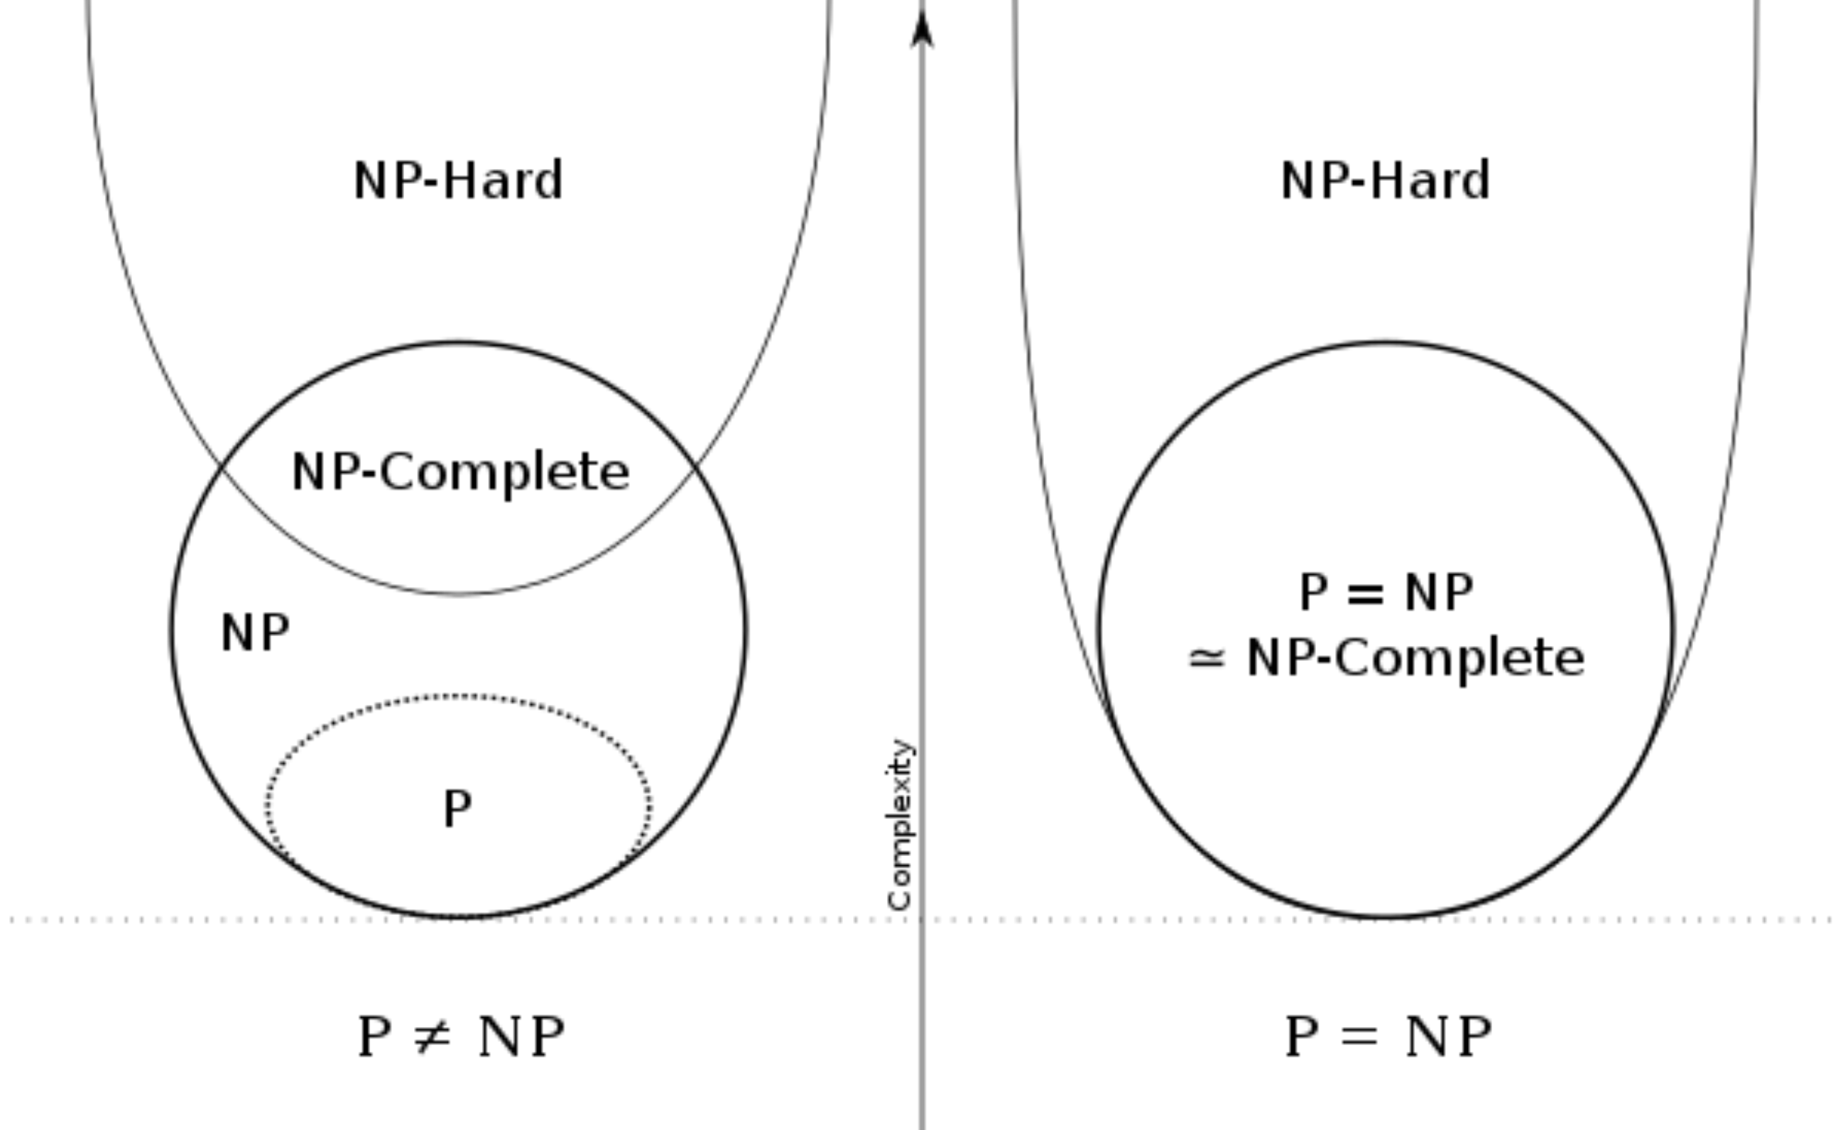
130.CSE105.NPCompleteness.mp4
Important diagram:

Slide 35
Reductions to the rescue Sipser p. 299-305
1970s Stephen Cook and Leonid Levin independently and in parallel lay foundations of NP-completeness
Definition A language B is NP-complete if (1) it is in NP and
(2) every A in NP is polynomial-time reducible to it.
Problems that satisfy (2) are called NP-hard

Slide 36
Reductions to the rescue Sipser p. 299-305
1970s Stephen Cook and Leonid Levin independently and in parallel lay foundations of NP-completeness
Definition A language B is NP-complete if (1) it is in NP and
(2) every A in NP is polynomial-time reducible to it.
Consequence If an NP-complete problem has a polynomial time solution then all NP problems are polynomial time solvable.

Slide 37
Reductions to the rescue Sipser p. 271,276
What would prove that P = NP?
Showing that a problem solvable by brute-force methods has a nondeterministic solution.
Showing that there are two distinct NP-complete problems.
Finding a polynomial time solution for an NP-complete problem.
Proving that an NP-complete problem is not solvable in polynomial time.
I don't know
1970s Stephen Cook and Leonid Levin indepdendently and in parallel lay foundations of NP-completeness
Definition A language B is NP-complete if (1) it is in NP and
(2) every A in NP is polynomial-time reducible to it.
Consequence If an NP-complete problem has a polynomial time solution then all NP problems are polynomial time solvable

Slide 38


Reductions to the rescue Sipser p. 271,276
What would prove that P = NP?
Showing that a problem solvable by brute-force methods has a nondeterministic solution.
Showing that there are two distinct NP-complete problems.
Finding a polynomial time solution for an NP-complete problem.
Proving that an NP-complete problem is not solvable in polynomial time. ➔P ≠ NP
I don't know
1970s Stephen Cook and Leonid Levin indepdendently and in parallel lay foundations of NP-completeness
Definition A language B is NP-complete if (1) it is in NP and
(2) every A in NP is polynomial-time reducible to it.
Consequence If an NP-complete problem has a polynomial time solution then all NP problems are polynomial time solvable

Slide 39
Key Notation and Definitions (130)
A language B is NP-complete if
It is in NP
Every problem in NP is polynomial-time reducible to it
No problem in NP is harder than B.
NP-complete problems are the hardest among NP problems.
If an NP-complete problem has a polynomial time solution, then all NP problems are polynomial-time solvable.

Slide 40
131.CSE105.NPCompleteSAT.mp4
Remember:

Slide 41
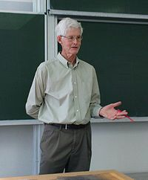

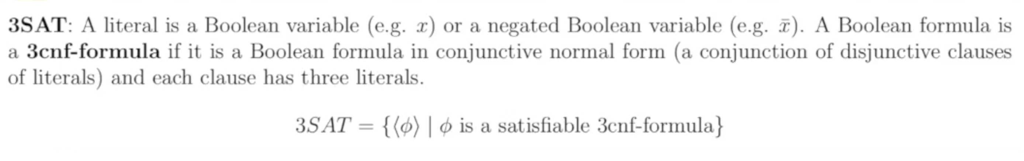
SAT and 3SAT Rosen p. 299
Cook-Levin Theorem: (3)SAT is NP-complete.

Slide 42
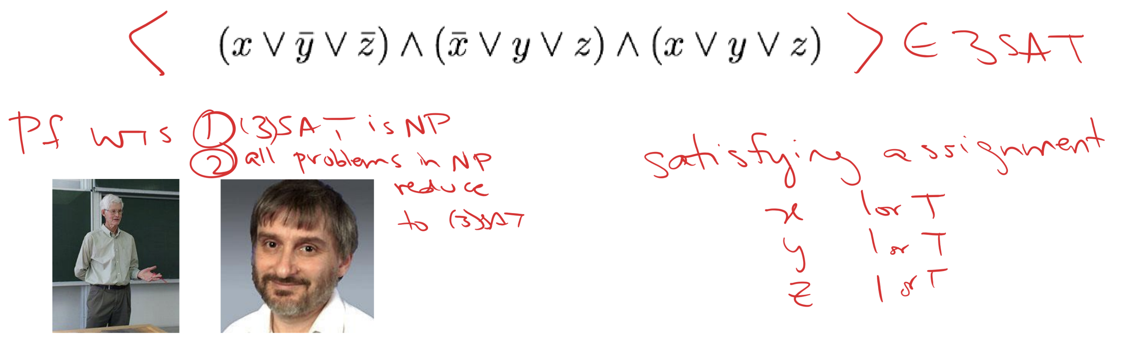
SAT and 3SAT Rosen p. 299
Cook-Levin Theorem: (3)SAT is NP-complete.

Slide 43
Are other problems NP complete?
To prove that X is NP-complete
From scratch: Prove it is NP, and that all NP problems are polynomial-time reducible to it.
Using reduction: Show that a (known-to-be) NP complete problem reduces to it.

Slide 44
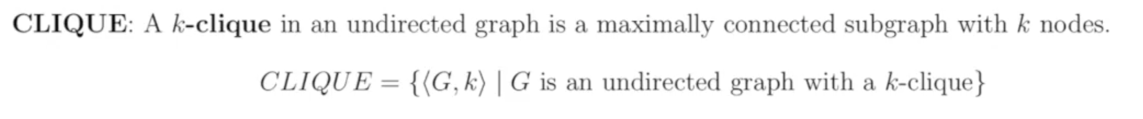
3SAT polynomial-time reduces to CLIQUE
Sipser p. 302
Given: Boolean formula in CNF with exactly 3 literals/clause
- AND of ORs - args in OR clauses: var or negated var
Desired Answer: Yes if satisfiable; No if unsatisfiable
Instead transform formula to graph so that graph has clique iff original formula is satisfiable

Slide 45
3SAT polynomial-time reduces to CLIQUE
Transform 3-CNF formula with k clauses to graph G
vertices are the literals in each clause
edges between all vertices except
two literals in the same clause
literals that are negations of one another
Claim: formula is satisfiable iff G has k-clique

Slide 46
3-SAT to Clique example

Slide 47
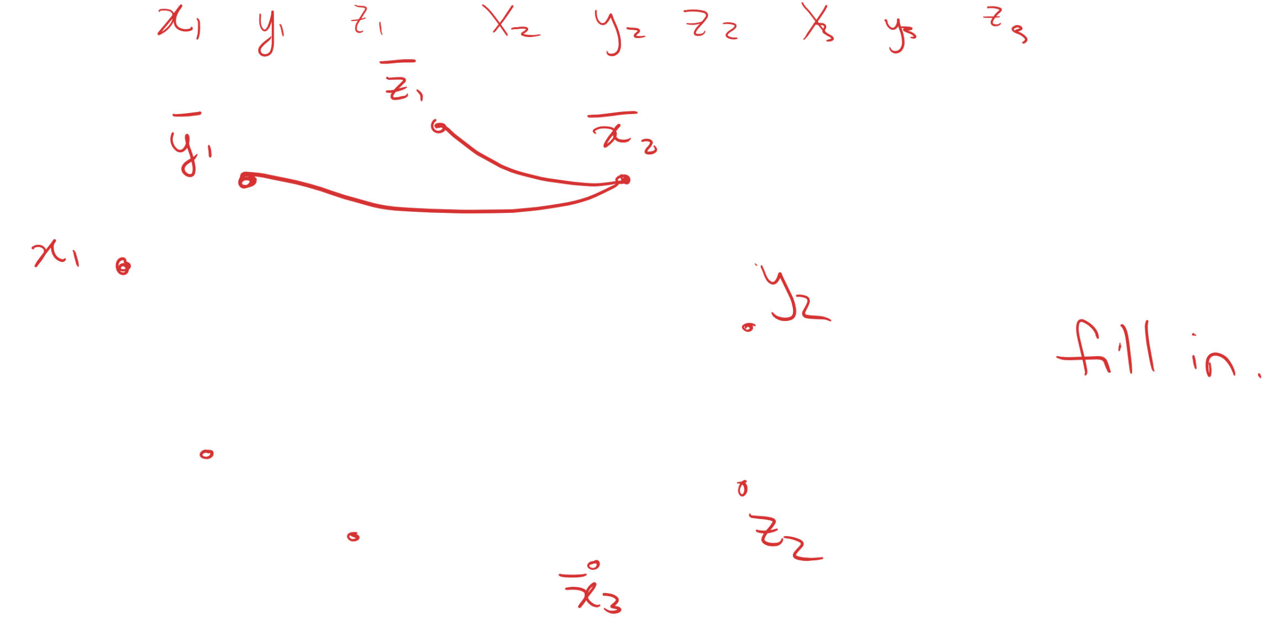
3-SAT to Clique example

Slide 48
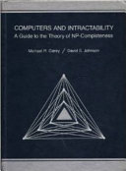
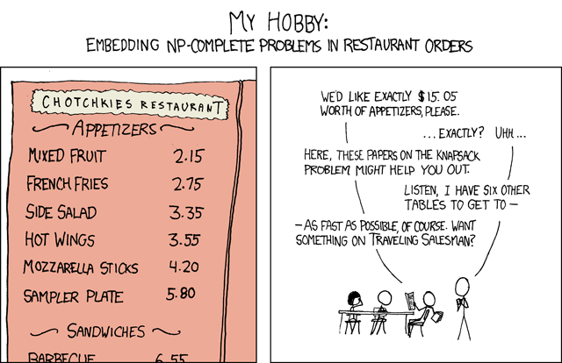


Are other problems NP-complete?

Slide 49
Key Notation and Definitions (131)
Cook-Levin Theorem: (3)SAT is NP-complete.
All problems in NP are polynomial-time reducible to 3SAT!!!
For example, a k-CLIQUE problem can be reduced to 3SAT.

Slide 50
Closure of NP under star
Example 1
Ch. 7 Problems pg. 323

Slide 51
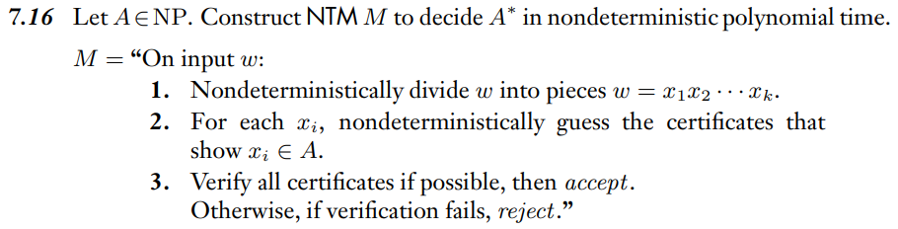
Example 1 Solution
Ch. 7 Solutions pg. 329

Slide 52
Wednesday FAQ (130-131)
Q: How much do we need to know about complexity?
A: You should be able to explain P, NP, NP-complete and give examples of each one. You also need to know why finding that P=NP is true or false would be significant.
Q: Are all NP-complete problems undecidable?
A: No. None are! A problem is NP-complete means that is in NP (and all NP problems are polynomial time reducible to it) so there is a Turing machine that decides it.

Slide 53
Wednesday FAQ (130-131) cont.
Q: Why is it true that if a problem in NP-complete is found to be reducible to a problem in P, then P = NP?
A: Problems in NP-complete are the hardest problems in NP. If one of the hardest problems in NP is reducible to a problem in P, it means that the hardest problems in NP are no harder than the problems in P. Therefore, all the rest of the problems in NP, which we know are all less hard than those in NP-complete, would also be no harder than those in P. If this was true, then P and NP would contain all the same problems and be equal.

Slide 54
Friday
Final review
Today’s learning goals
Summarize key concepts, ideas, themes from CSE 105.
Approach your final exam studying with confidence.
Identify areas to focus on while studying for the exam.
Today’s textbook sections
None

Slide 55
Universe: P(Σ*)
Recognizable
Decidable
NP
P
CF
Regular

Slide 56
Model of computation Formal definition? Design? Describe language? | Class of languages Closure properties? Which languages not in class?
Finite automata -- DFA -- NFA equiv to Regular expressions | Regular languages To show not in class: Pumping lemma
Push-down automata CFGs | Context-free languages
TMs that always halt in polynomial time | P
Nondeterministic TMs that halt in polynomial time | NP
TMs that always halt aka Deciders | Decidable languages To show not in class: Diagonalization, mapping reduction
Turing Machines (in general; may not halt) | Recognizable languages

Slide 57
Roadmap of examples
Regular language design
Undecidability via mapping reduction
Closure proofs
Determining the language of a PDA /CFG
Using Pumping Lemma

Slide 58
Given L, prove it is regular
Construction
Strategy 1: Construct DFA
Strategy 2: Construct NFA
Strategy 3: Construct regular expression
Proof of correctness
WTS 1 if w is in L then w is accepted by ….
WTS 2 if w is not in L then w is rejected by …

Slide 59
Ex: L= { w in {0,1}* | w has odd # of 1s OR starts with 0}
NFA:
Regular expression:
Notes:
DFA: 2 states
Reg exp: (0*1) ((0*1)(0*1))* 0* U 0(0U1)*

Slide 60
To show a language is not regular, we can
Show there is a CFG generating A.
Use the pumping lemma for regular languages.
Show A is undecidable.
More than one of the abve.
I don't know.
Notes:
DFA: 2 states
Reg exp: (0*1) ((0*1)(0*1))* 0* U 0(0U1)*

Slide 61
To show a language L is …
Recognizable
Show there is a TM M with L(M) = L.
Find a recognizable problem L' and show L mapping reduces to L'
Use closure properties.
Not recognizable
Prove that L is not decidable and that the complement of L is recognizable.
Find an unrecognizable problem L' and show L' mapping reduces to L.
Use closure properties.

Slide 62
To show a language L is …
Decidable
Show there is a TM D that always halts and L(D) = L.
Find a decidable problem L' and show L mapping reduces to L'
Use closure properties.
Not decidable
Use diagonalization
Find an undecidable problem L' and show L' mapping reduces to L.
Use closure properties.

Slide 63
T = { <M> | M is TM and |L(M)| = 1}
Theorem: Problem T is undecidable.
Proof
Goal: find mapping reduction from A_{TM} to T.
Define F = "On input x
Type check …
Build machine …
Output code for machine…
Claim: x is in A_{TM} iff F(x) is in T.

Slide 64
Countable and uncountable
Countable
Find bijection with N
Find a countable superset
Examples
Any language over Σ
Set of all regular languages
Set of rational numbers
Set of integers
Uncountable
Diagonalization
Find an uncountable subset
Examples
Set of all subsets of Σ*
Set of infinite binary sequences
Set of real numbers
[0,1]

Slide 65
Closure properties
 | Regular Languages | CFL | Decidable Languages | Recognizable Languages
Union | ✔ | ✔ | ✔ | ✔
Intersection | ✔ | ✗ | ✔ | ✔
Complement | ✔ | ✗ | ✔ | ✗
Star | ✔ | ✔ | ✔ | ✔
Concatenation | ✔ | ✔ | ✔ | ✔

Slide 66
Proving closure
Goal: "The class of ____ languages is closed under _____"
In other words Given a language in specific class, is the result of applying the operation _____ to this language still guaranteed to be in the class?

Slide 67
Proving closure
Given: What does it mean for L to be in class?
e.g. L a regular language, so given a DFA
M_{L} = (Q_{L}, Σ_{L}, δ_{L},q_{L},F_{L})
with L(M_{L}) = L. Name each of the pieces!
WTS: The result of applying the operation to L is still in this class.
Construction: Build a machine that recognizes the result of applying the operation to L. Start with description in English!
e.g. Let M = (Q, Σ, δ, q₀, F) where Q=… Σ=… δ=… q₀=…F=..
M could be DFA or NFA
Correctness: Prove L(M) = result of applying operation to L
WTS1 if w is in set then w is accepted by M
WTS2 if w is not in the set then w rejected by M.

Slide 68
Claim: The class of recognizable languages is closed under concatenation
Given
WTS
Construction
Correctness

Slide 69
Claim: The class of recognizable languages is closed under concatenation
Given Two recognizable languages A,B and TMs that recognize them: M_{A} with L(M_{A}) = A and M_{B} with L(M_{B}) = B.
WTS The language AB is recognizable.
Construction Define the TM M as "On input w,
Nondeterministically split w into w = xy.
Simulate running M_{A} on x. If rejects, reject; if accepts go to 3.
Simulate running M_{B} on y. If rejects, reject; if accepts, accept."
Correctness

Slide 70
Construction Define the TM M as "On input w,
Nondeterministically split w into w = xy.
Simulate running M_{A} on x. If rejects, reject; if accepts go to 3.
Simulate running M_{B} on y. If rejects, reject; if accepts, accept.
Correctness Claim that w is in AB iff w is in L(M).
Part 1: Assume w is in AB. Then there are strings x,y such that w = xy and x is in A, y is in B. Running M on w, one of the nondeterministic ways we split w will be into these x,y. In step 2, the computation of M_{A} on x will halt and accept (because L(M_{A}) = A) so we go to step 3. In that step, the computation of M_{B} on y will halt and accept (because L(M_{B}) = B so M accepts w.

Slide 71
Construction Define the TM M as "On input w,
Nondeterministically split w into w = xy.
Simulate running M_{A} on x. If rejects, reject; if accepts go to 3.
Simulate running M_{B} on y. If rejects, reject; if accepts, accept.
Correctness Claim that w is in AB iff w is in L(M).
Part 2: Assume w is not in AB. Then there are no strings x,y such that w = xy and x is in A, y is in B. In other words, for each way of splitting w into xy, at least one of the following is true: M_{A} running on x will reject or loop, M_{B} running on y will reject or loop. Tracing the computation of M on w, in each one of the nondeterministic computation paths, there is some split w=xy. For each of these splits, in step 2, the computation of M_{A} on x either loops (in which case M loops on w, so w is not in L(M)) or rejects (in which case M rejects w) or accepts (in which case M goes to step 3). If the computation of M enters step 3, this means that x is in L(M_{A}) so by our assumption, y is not in L(M_{B}) so M_{B} on y must either loop or reject. In either case, M rejects. Thus w is not in L(M).

Slide 72
Proving closure
Given: What does it mean for L to be in class?
e.g. L a regular language, so given a DFA M_{L} = (Q_{L}, Σ_{L}, δ_{L},q_{L},F_{L})
with L(M_{L}) = L. Name each of the pieces!
WTS: The result of applying the operation to L is still in this class.
Construction: Build a machine that recognizes the result of applying the operation to L. Start with description in English!
e.g. Let M = (Q, Σ, δ, q₀, F) where Q=… Σ=… δ=… q₀=…F=..
M could be DFA or NFA
Correctness: Prove L(M) = result of applying operation to L
WTS1 if w is in set then w is accepted by M
WTS2 if w is not in the set then w rejected by M.
To prove the class of recognizable languages is closed under _____ the constructions may involve building a
Two-tape Turing machine.
Nondeterministic decider.
Enumerator.
All of the above.
I don't know.

Slide 73
Claim: The class of decidable languages is closed under reversal
Given
WTS
Construction
Correctness

Slide 74
Claim: The class of decidable languages is closed under reversal
Given A decidable language L, with a decider TM D: L(D)=L
WTS There is a decider that decides L^{R} = {w | w^{R} is in L}
Construction Define the TM M as "On input w:
Make a copy of w in reverse.
Simulate running D on this copy.
If D accepts, accept. If D rejects, reject.
Correctness If w is in L^{R} then in step 1, M builds w^{R} and in step 2, the computation of D on w^{R} will accept (because L(D) = L), so in step 3, M accepts w. If w is not in L^{R} then in step 1, M builds w^{R} and in step 2, the computation of D on w^{R} will rejept (because L(D) = L), so in step 3, M rejects w.

Slide 75
Claim: The class of decidable languages is closed under reversal
Given A decidable language L, with a decider TM D: L(D)=L
WTS There is a decider that decides L^{R} = {w | w^{R} is in L}
Construction Define the TM M as "On input w:
Make a copy of w in reverse.
Simulate running D on this copy.
If D accepts, accept. If D rejects, reject.
Correctness If w is in L^{R} then in step 1, M builds w^{R} and in step 2, the computation of D on w^{R} will accept (because L(D) = L), so in step 3, M accepts w. If w is not in L^{R} then in step 1, M builds w^{R} and in step 2, the computation of D on w^{R} will rejept (because L(D) = L), so in step 3, M rejects w.
Is this how we proved that the class of regular languages is closed under reversal?
Yes.
No – but we could modify our earlier proof to make a copy of w^{R} and then run the DFA on it.
No – and this strategy won't work for automata.
I don't know.

Slide 76
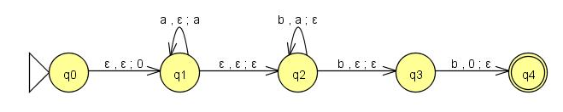
What is the language of this PDA?
A. {w | # of b's in w ≥ # of a's in w}
B. {w | w = a^{n}b^{n+1} for some n≥0}
C. {w | w = a^{n}b^{n+2} for some n≥0}
D. {w | w = a^{n}b^{2n} for some n≥0}
E. {w | w = 0a^{n}b^{2n}0 for some n≥0}

Slide 77
What is the language of CFG
with rules
S → aSb | bY | Ya
Y → bY | Ya | ε
Notes:
How to analyze: What is the shortest string? b or a How do you add on to string? First rule gives you equal no of a’s at beg and b’s at end. But then take bY or Ya.
Y gives you any number of b’s followed by any number of a’s. So L = { a^n w b^n | n >= 0 and w = b^k a^j where k,j >= 0 and at least one of k,j >= 1}

Slide 78
(Using) Pumping Lemma
Theorem: L = {w w^{R} | w is in {0,1}* } is not regular.
Proof (by contradiction): Assume, towards a contradiction, that L is regular. Then by the Pumping Lemma, there is a pumping length, p, for L. Choose s to be the string ________. The Pumping Lemma guarantees that s can be divided into parts s=xyz such that |xy| ≤p, |y|>0, and for any i≥0, xy^{i}z is in L. But, if we let i=____, we get the string ______ which is not in L, a contradiction. Thus L is not regular.

Slide 79
(Using) Pumping Lemma
A. s = 000000111111, i=6
B. s=0^{p}0^{p}, i=2
C. s=0^{p}110^{p}, i=2
D. More than one of the above.
E. I don't know.
Theorem: L = {w w^{R} | w is in {0,1}* } is not regular.
Proof (by contradiction): Assume, towards a contradiction, that L is regular. Then by the Pumping Lemma, there is a pumping length, p, for L. Choose s to be the string ________. The Pumping Lemma guarantees that s can be divided into parts s=xyz such that |xy| ≤p, |y|>0, and for any i≥0, xy^{i}z is in L. But, if we let i=____, we get the string ______ which is not in L, a contradiction. Thus L is not regular.

Slide 80
P and NP
P: Languages decidable in polynomial time on deterministic Turing machines.
e.g. PATH, Simple arithmetic, CFL's, etc.
NP: Languages decidable in polynomial time on nondeterministic Turing machines.
e.g. TSP, SAT, CLIQUE, etc.
Know P is a subset of NP and
if an NP-complete problem is in P, then P=NP.

Slide 81
Universe: P(Σ*)
Recognizable
Decidable
NP
P
CF
Regular

Slide 82

Recognizable

